Slide 1
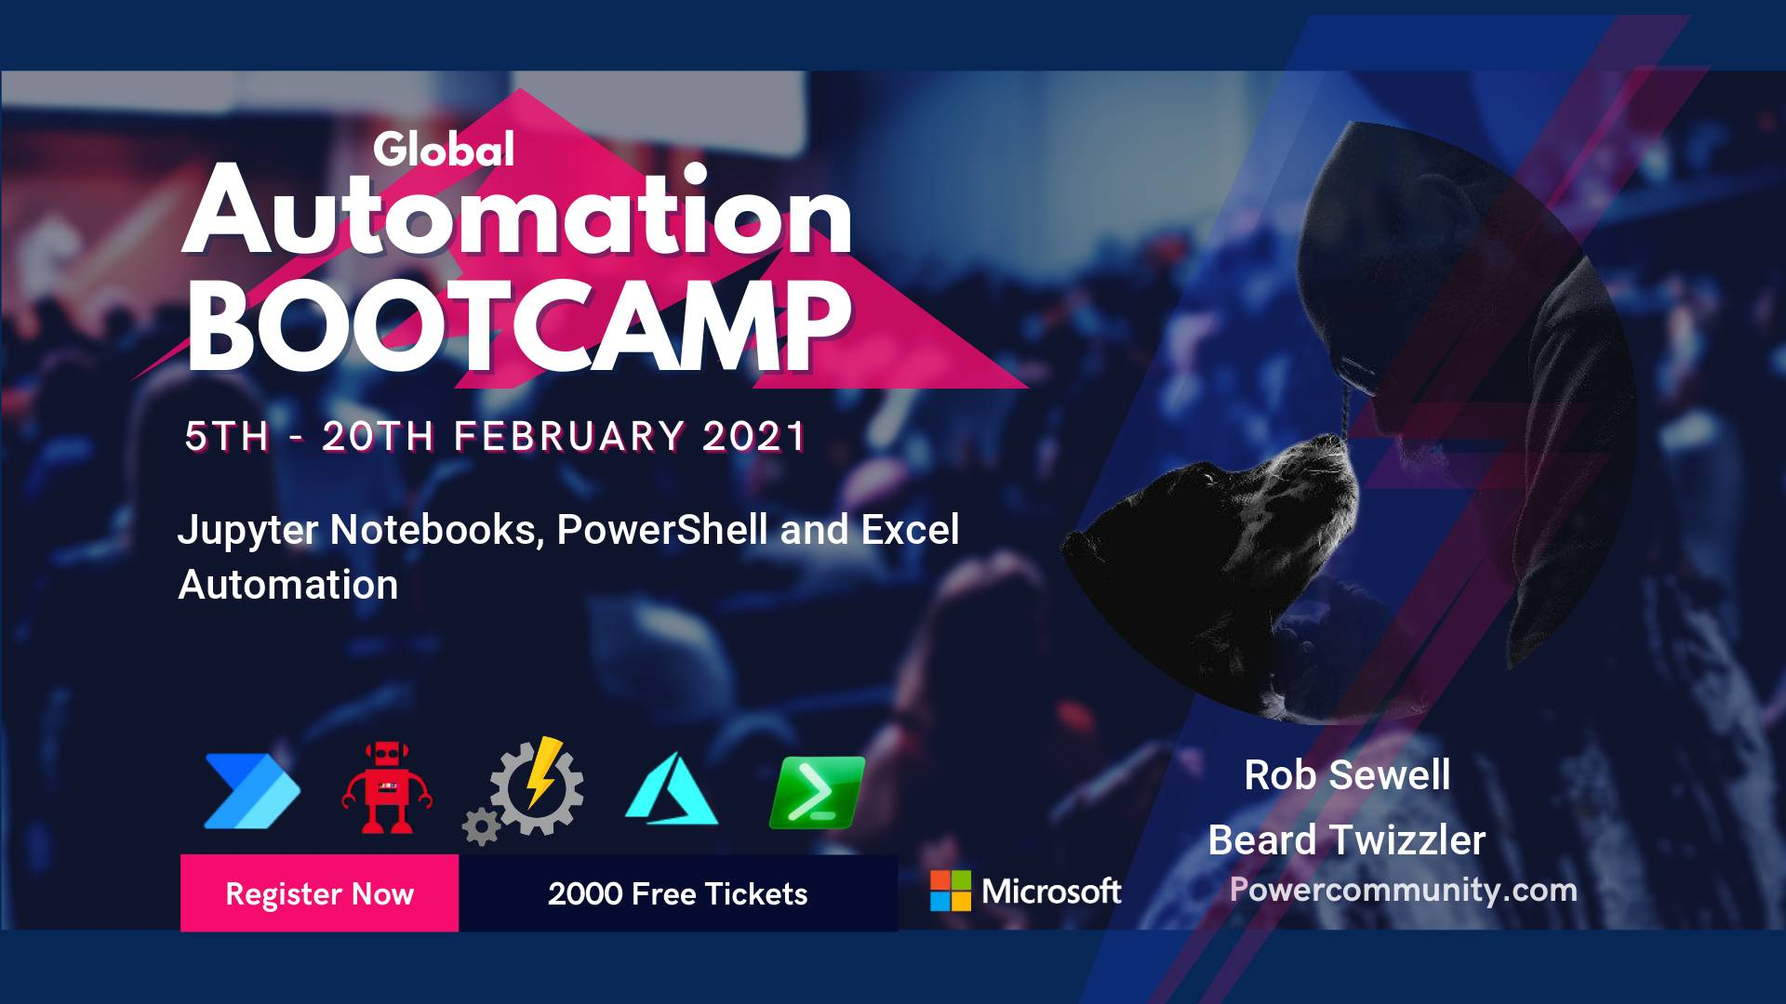

Everything is Awesome

Slide 2
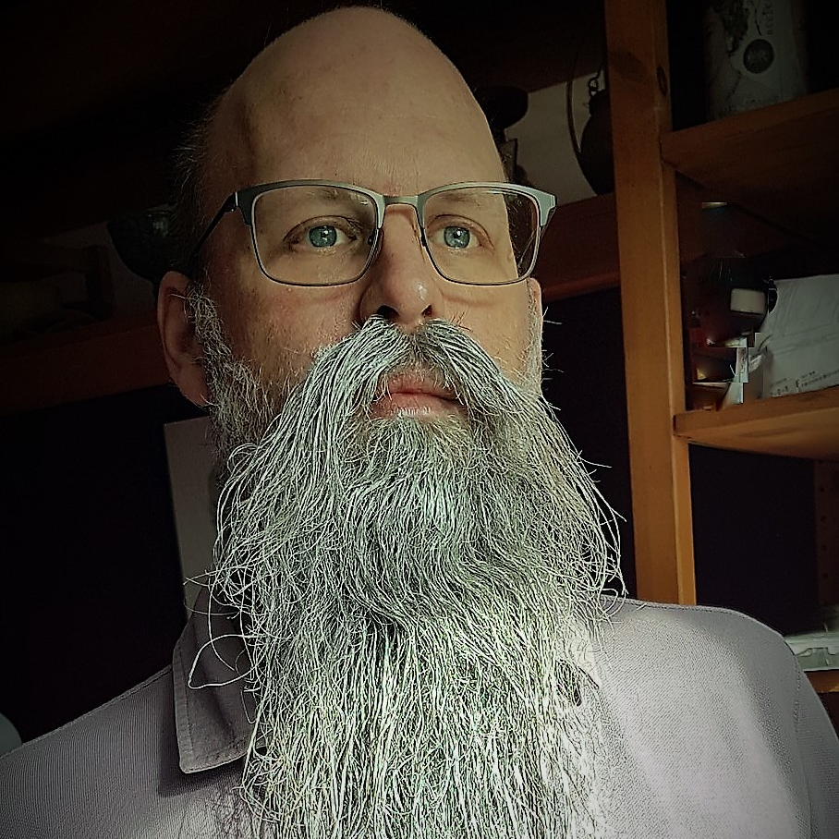
Rob Sewell
Bearded Consultant
Automator
Trainer
Dual MVP
He/Him
Consultant Sewells Consulting Ltd
dbatoolsMoL dbachecks
ADSNotebooks PowerShell Community
Data Community
beard.media\book
@sqldbawithbeard
blog.robsewell.com

Slide 3
Rob Sewell
Bearded Consultant
Automator
Trainer
Dual MVP
Consultant Sewells Consulting Ltd
dbatoolsMoL dbachecks
ADSNotebooks PowerShell Community
Data Community
beard.media\book
@sqldbawithbeard
blog.robsewell.com
Notes:
OBS:SpeakerCircle

Slide 4
Rob Sewell
Bearded Consultant
Automator
Trainer
Dual MVP
Consultant Sewells Consulting Ltd
dbatoolsMoL dbachecks
ADSNotebooks PowerShell Community
Data Community
beard.media\book
@sqldbawithbeard
blog.robsewell.com
Notes:
OBS:SpeakerCircleandSide

Slide 5
Ask me questions anytime
Slides are always here - https://beard.media/presentations Notebooks are here - https://beard.media/Notebooks @SQLDbaWithBeard – Is where to find me later blog.robsewell.com – Is where to read things!
Notes:
OBS:Full Screen

Slide 6
Pop Quiz
In organisations – where is most data used ?
Notes:
OBS:Full Screen

Slide 7

Notes:
OBS:Full Screen

Slide 8
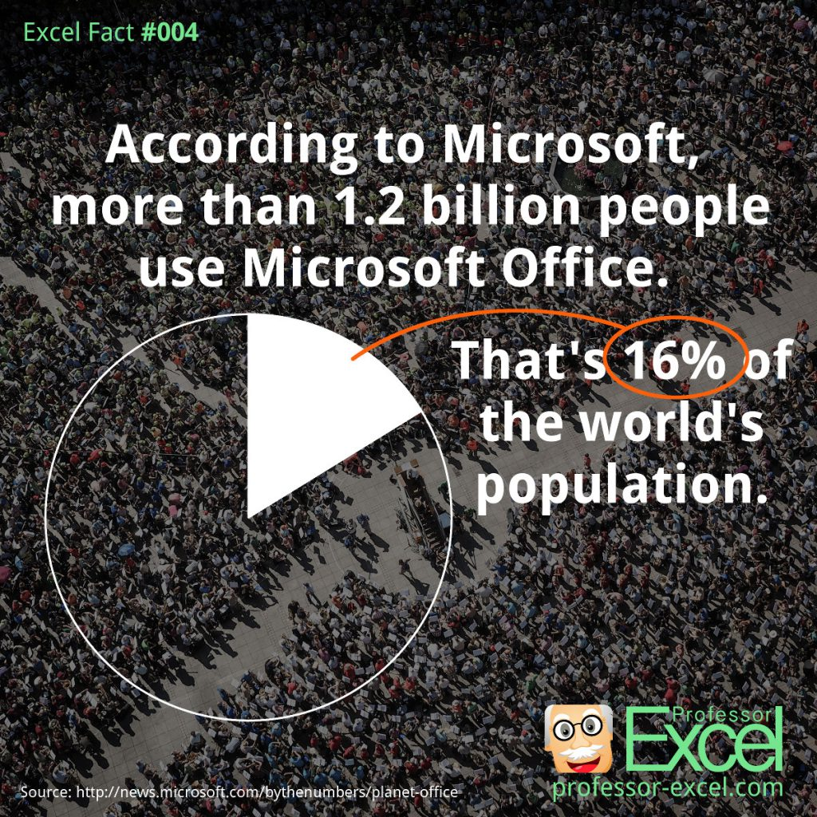
Notes:
OBS:SpeakerRightHalf

Slide 9

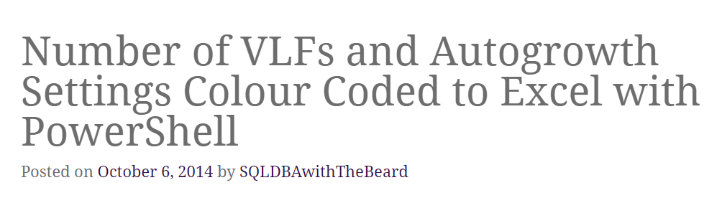
Notes:
OBS:SpeakerCentreBottom

Slide 10
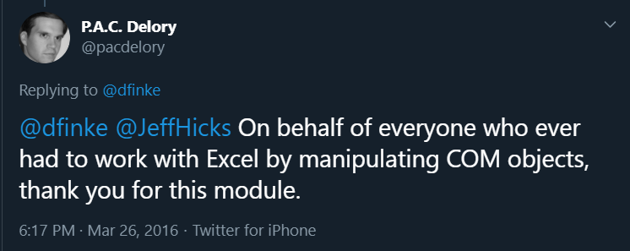
Notes:
OBS:SpeakerCentreBottom

Slide 11
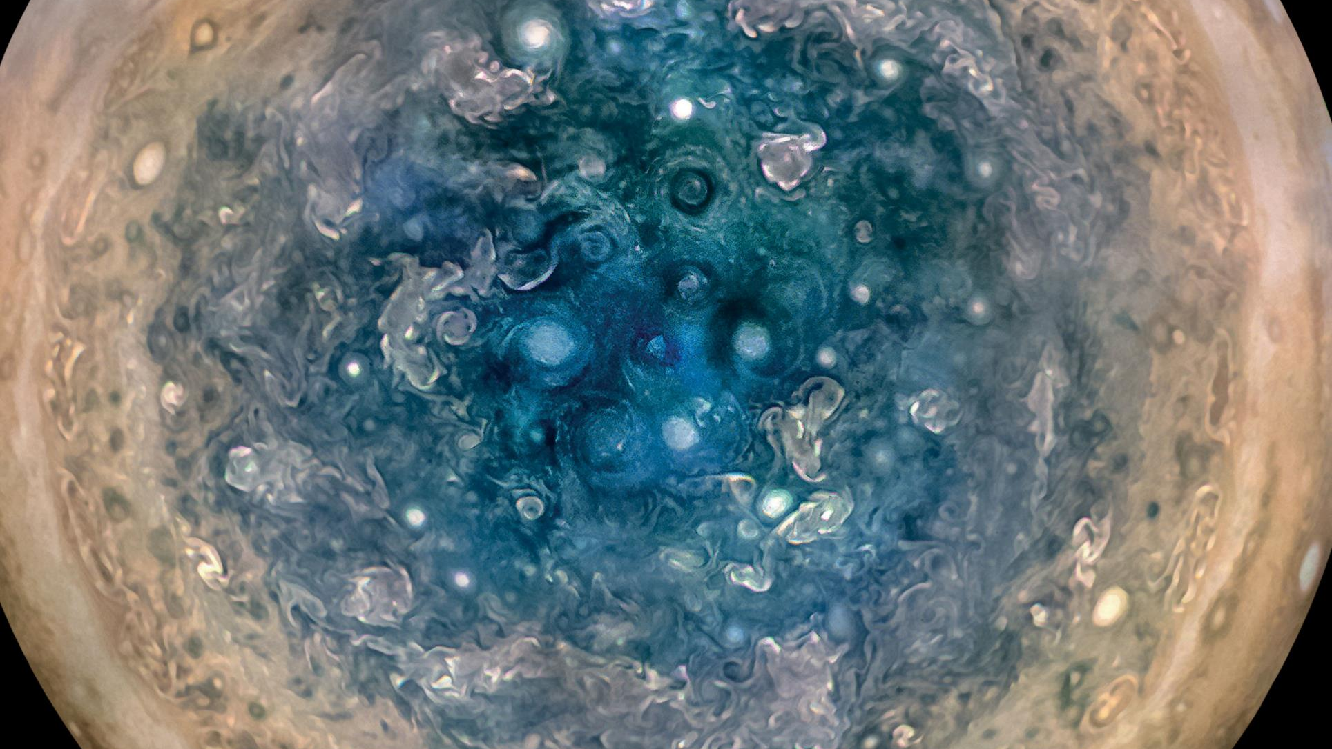
Notes:
OBS:Full Screen

Slide 12

So – What IS a Jupyter Notebook?
Originally for Data Scientists
Notes:
OBS:SpeakerTinySquare

Slide 13
What is a Jupyter Notebook?
Document that can contain text, code, images and query results
Notes:
OBS:SpeakerCentreBottom

Slide 14
What is a Jupyter Notebook?
Document that can contain text, code, images and query results
Notes:
OBS:SpeakerCentreBottom

Slide 15
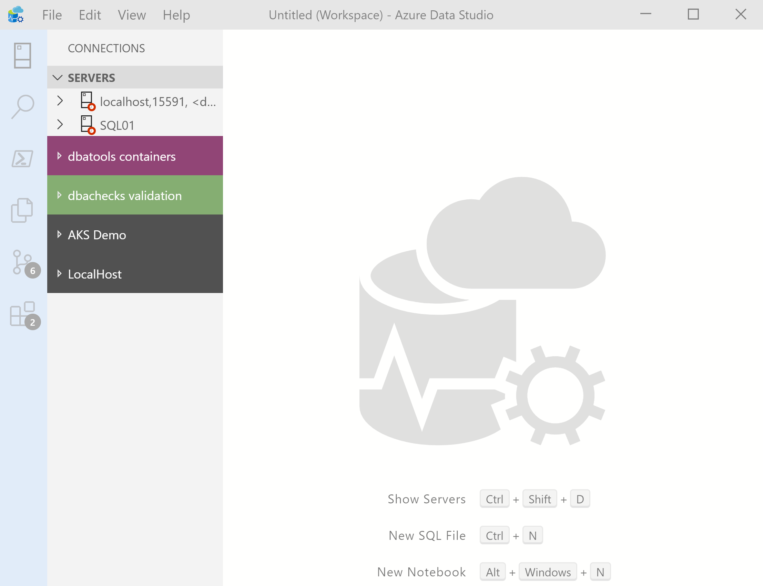
What’s Azure Data Studio ?
Cross Platform desktop environment for Data Professionals
Notes:
OBS:SpeakerCentreBottom

Slide 16
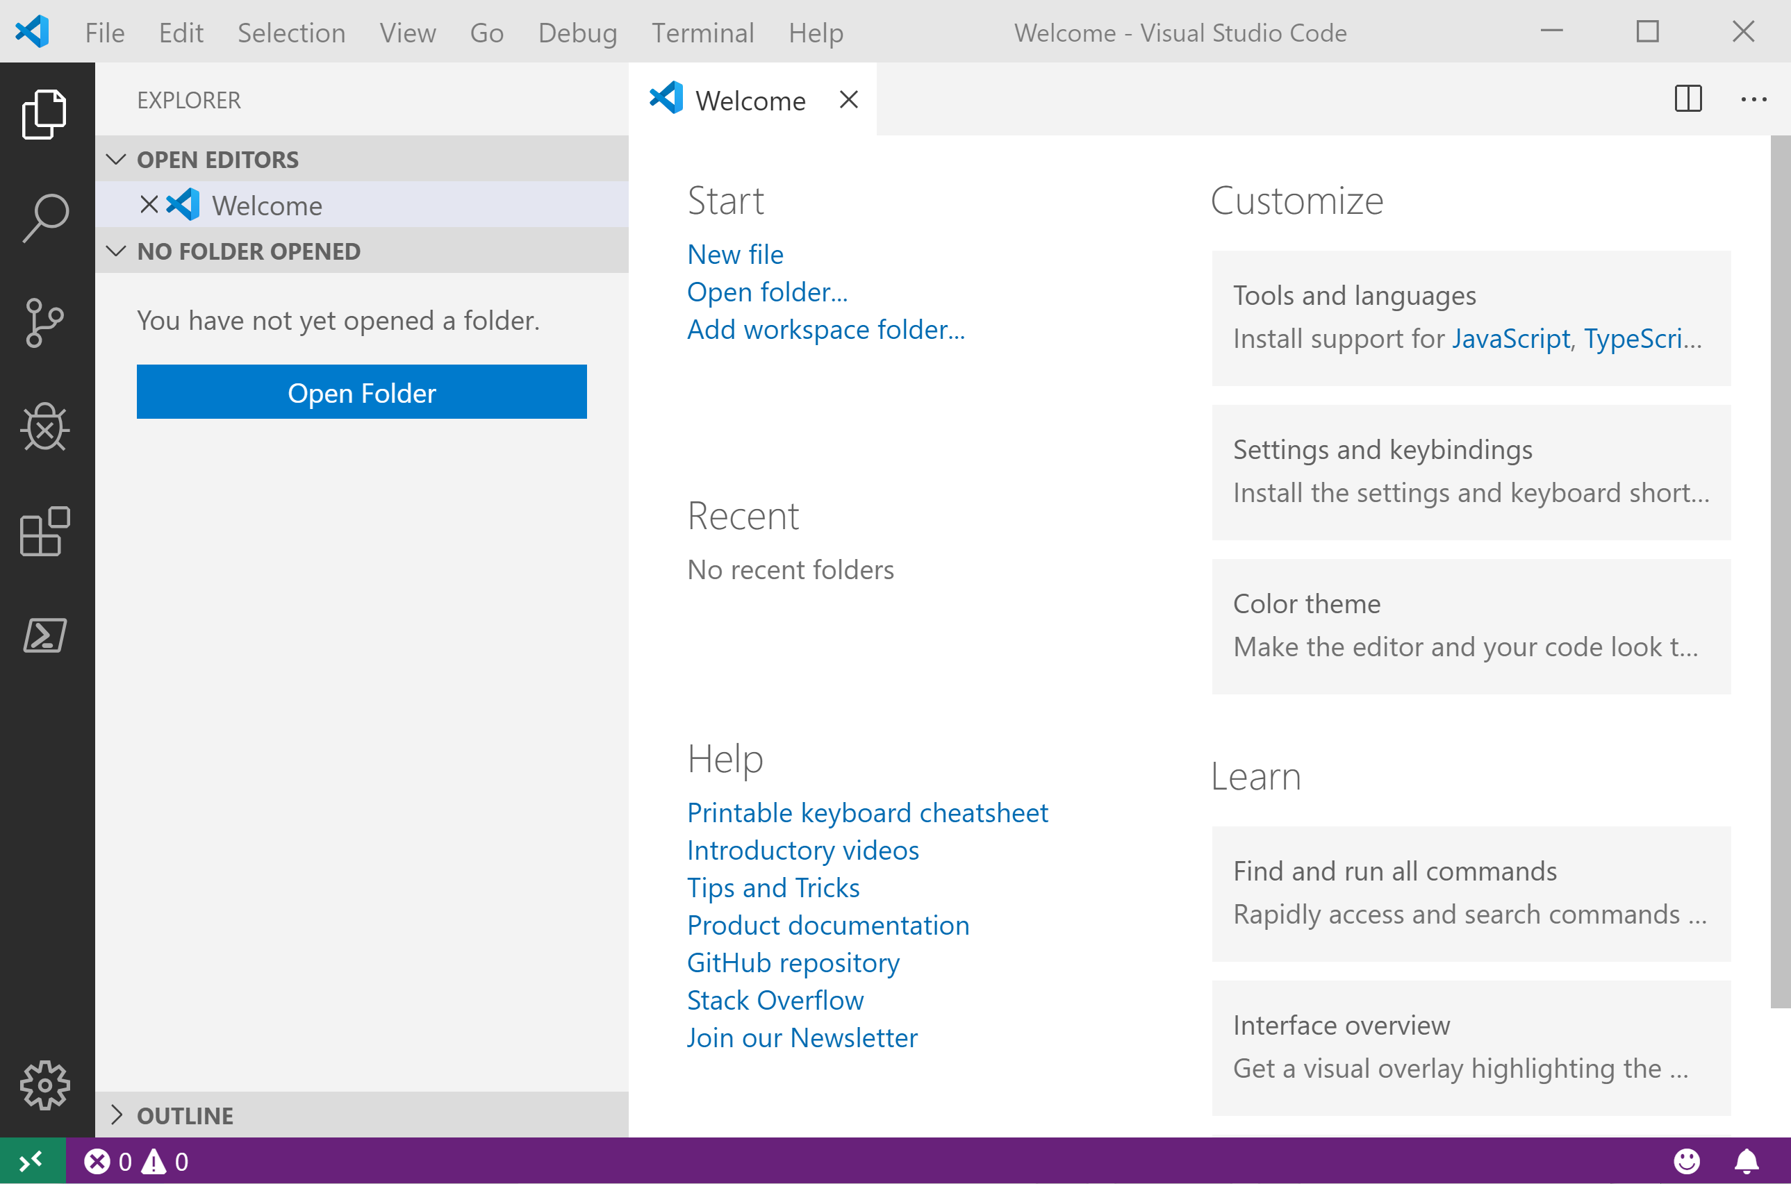
It Looks Like Visual Studio Code ?
Notes:
OBS:SpeakerCentreSquare

Slide 17
It Looks Like Visual Studio Code ?
Notes:
OBS:SpeakerCentreBottom

Slide 18

Time For A DEMO

Slide 19
Wondering how I did this?
Bit of PowerShell
PowerPoint
And StreamLabs Obs
https://beard.media/slobsautomation
Notes:
OBS:SpeakerTopRight

